Slide 1
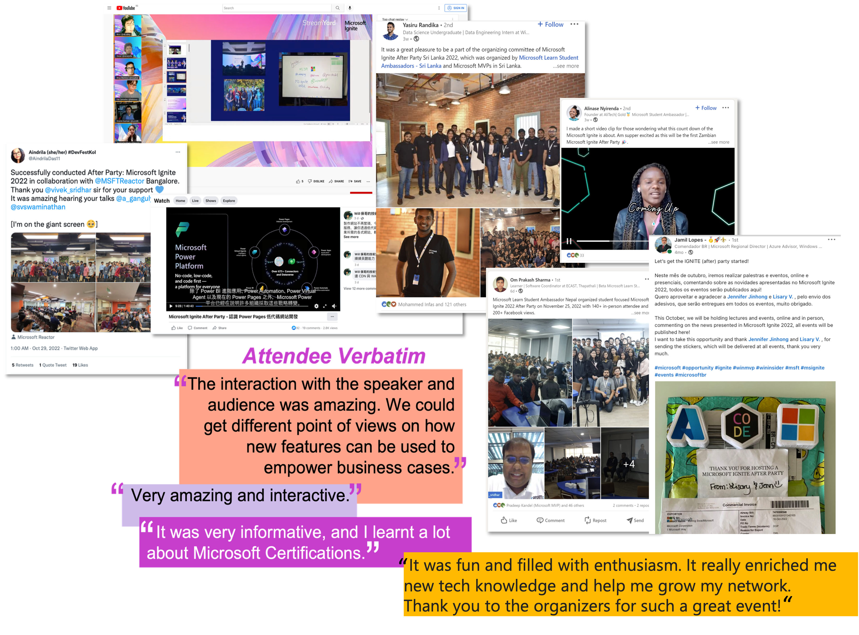
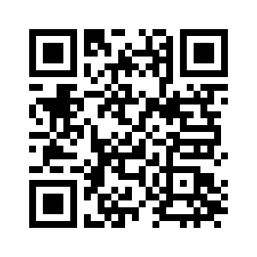
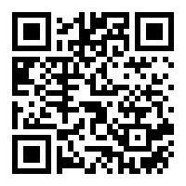
Microsoft Build 2023 Community-Led Parties
Your learning goes beyond Microsoft Build.
Watch Microsoft Build together with a community group and hear what your peers have to say about your favorite tech topic at a Microsoft Build Community-led Party happening from May 22 to July 7 – in your preferred time zone and language!
Let's Watch together
https://aka.ms/MSBuild-WatchTogether
Build skills that open new doors:
https://aka.ms/BuildCollections-CommunityParties

